Slide 1
Welcome to
by
1
serviceredition.com

Slide 2
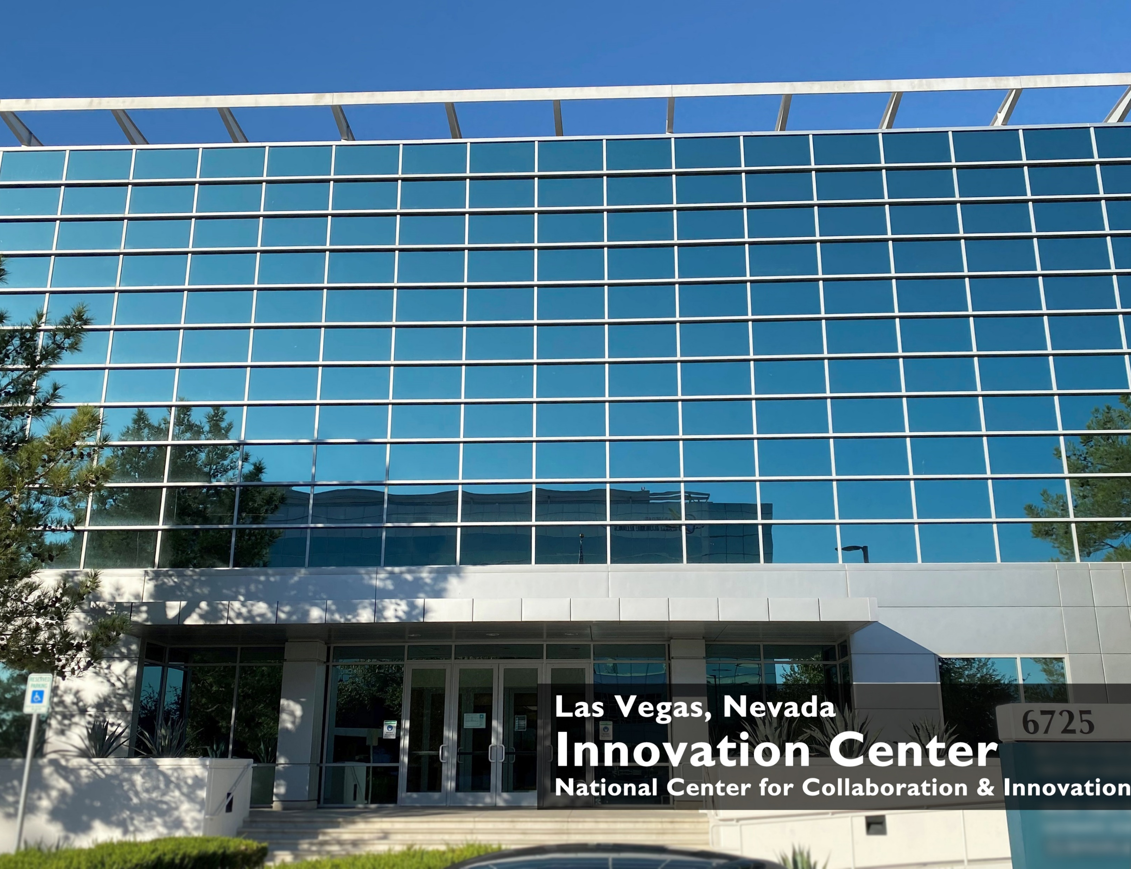
Connecting the Dots
CU*Answers is a CUSO and a Cooperative
Founded in 1970 and located in Grand Rapids, MI
We’re the only 100% CU-Owned Cooperative in our industry
We’re part of the cuasterisk.com network that reaches 350+ credit unions with over 3 million members and other businesses
A staff of nearly 300 industry professionals
Servicer Edition is a robust suite of core business tools
Headquartered at our Innovation Center in Las Vegas
CU*Answers owns the intellectual software rights to the Servicer Edition platform
The Servicer Edition brand is new, but the solutions it provides are proven.
1
serviceredition.com

Slide 3
What is Servicer Edition?
It’s a full stack of account servicing tools with the power of a core processing system that allows you to:
Get creative
Our customers have a say in the software solutions we create
Leverage your relationships
You have an experienced team at your disposal
350+ business partners sharing ideas that can benefit your organization
Simplify your technology decisions
Don’t have to worry about day-to-day operations
Access to a variety of resources under one roof
Analytics
Online Banking
Mobile Banking
Imaging
Call Center
LOS
3
serviceredition.com

Slide 4
Why is Servicer Edition Unique?
Because CU*Answers owns the Servicer Edition platform we can separate the software solutions. This allows you to:
use only what you need up front
flip the switch later and activate new services without delay
purchase Servicer Edition at a disruptive price point
One price for a full suite of products (No surprises later if you flip the switch on services you aren’t currently using)
More dollars plowed back into R&D
4
serviceredition.com

Slide 5
Fully-Integrated: Custom solutions
Three Key Benefits for your CUSO
Focus on Utilization: Collaborative Services
Our Cooperative’s vision is to give all CUSO’s – large and small – the tools and the skills they need to compete in the market – both now and into the future
Disruptive Pricing: Charge only when we must
1
2
3
5
serviceredition.com

Slide 6
Fully integrated: Custom solutions
1
What’s in the stack?
A complete customer service platform with trackers and optics
Online banking with content management
Mobile banking / Text banking / Mobile Apps
Native LOS/Mortgage, Business and Consumer Lending
Automated decisioning
Online debit and credit card servicing
e-Statements, e-Alerts, e-Notices
Marketing & Management Dashboards, CRM Tools & Alerts
Analytics
Multiple customer payment options
Document imaging built into the workflows
Our solution could include everything on this list.
Customize a plan for your business.
6
serviceredition.com

Slide 7
Focus on utilization: Collaborative Services
2
Accounting
Collections
Compliance
Vendor/Contract Management
Marketing and Social Media
Management consulting
Strategic Planning
Call Center (inbound & outbound)
IT (Network, Server, and PC management)
Web Design and Media Services
Imaging / Paperless
Mortgage Servicing
We use our software every day to deliver customized cooperative services to the businesses we serve. We use it – not just build it!
Before and during the conversion/installation, we work side-by-side with your team to understand their unique process and flow. Our subject matter experts learn from yours – then collaborate to create the best return from your Servicer Edition investment.
7
serviceredition.com

Slide 8
3
Disruptive Pricing: Charge only what we must
Visit www.serviceredition.com to learn more
Over the last 3 years we have:
reduced/eliminated $2.5M in fees
spent nearly $20M on R&D
8
serviceredition.com

Slide 9
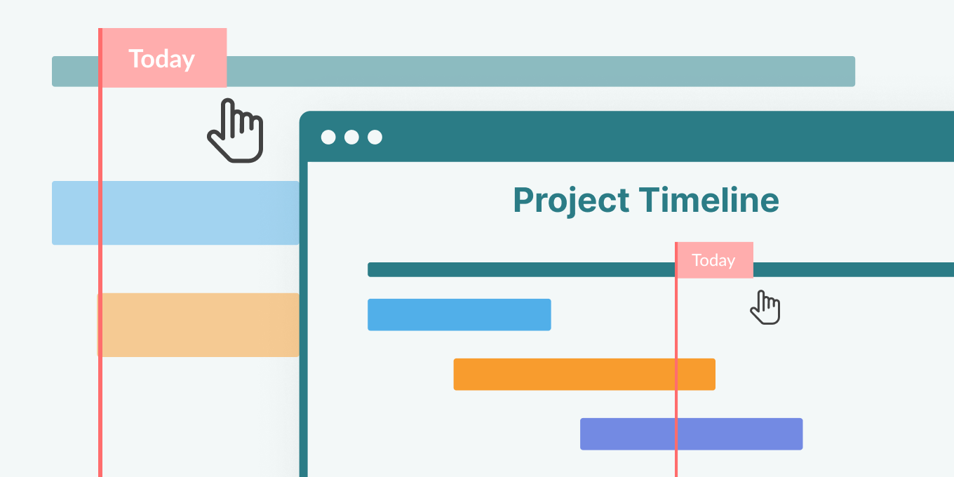
Our Onboarding Promise
Onboarding Made Easy!
The Framework
Product and Service Review Periods
Dedicated support for your management team
Personalized training for your operations
In Person Training
Leverage Zoom telepresence
In office live day support
Guided decision making for technology
9
serviceredition.com

Slide 10
We are committed to business continuity
A dedicated team monitoring your data 24x7
Rollover exercises twice a year to simulate a disaster scenario
Client Services thru midnight
FREE Education
A network of support partners across the U.S.
Collaboration with peers to ask question
Certified distributors and service partners
10
serviceredition.com

Slide 11
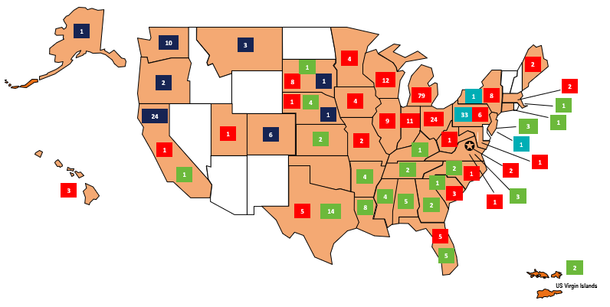
Let’s Grow Together!
We want to be your partner, not just your vendor.
Gain immediate access to:
350+ credit unions
8 innovative partners
Multiple SE partners
All from day one!

Slide 12
Next Steps
Scott Collins
EVP National Sales & Marketplace Relationships
scollins@cuanswers.com

